Slide 1
Math 769: Statistical Learning

Slide 2
Model Selection with AIC and BIC
Shahrzad Jamshidi, PhD

Slide 3
Last Time
We discussed model error and its relation to bias and variance.

Slide 4
Objectives
Define AIC and BIC and state their equations.
Compare and contrast the two metrics.
Identify how best to utilize them.

Slide 5
Bias-Variance Tradeoff and Metrics
Bias boils down to the worry of underfitting.
Variance boils down to the worry of overfitting.
Metrics like
the coefficient of determination,
the mean squared error, and
the mean absolute error
can be blind to model complexity—which increases variance.

Slide 6
Information Criterion
Two popular information criteria for model selection are
the Akaike Information Criterion (AIC) and
the Bayesian Information Criterion (BIC).
Both serve to penalize complexity to avoid overfitting while rewarding good fit.

Slide 7
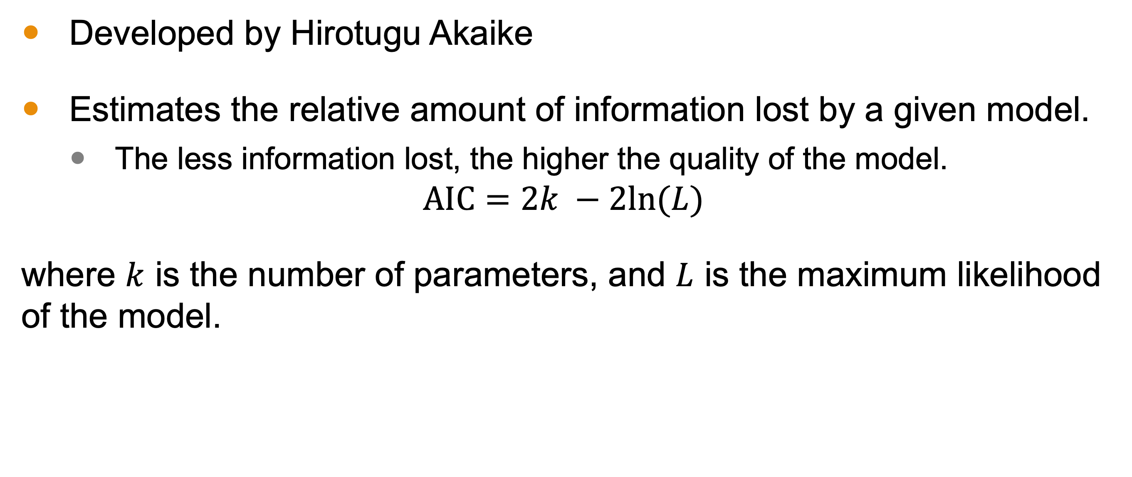
Akaike Information Criterion (AIC)
Developed by Hirotugu Akaike
Estimates the relative amount of information lost by a given model.
The less information lost, the higher the quality of the model.
$$AIC=2k −2ln⁡(L)$$
where $k$ is the number of parameters, and $L$ is the maximum likelihood of the model.

Slide 8
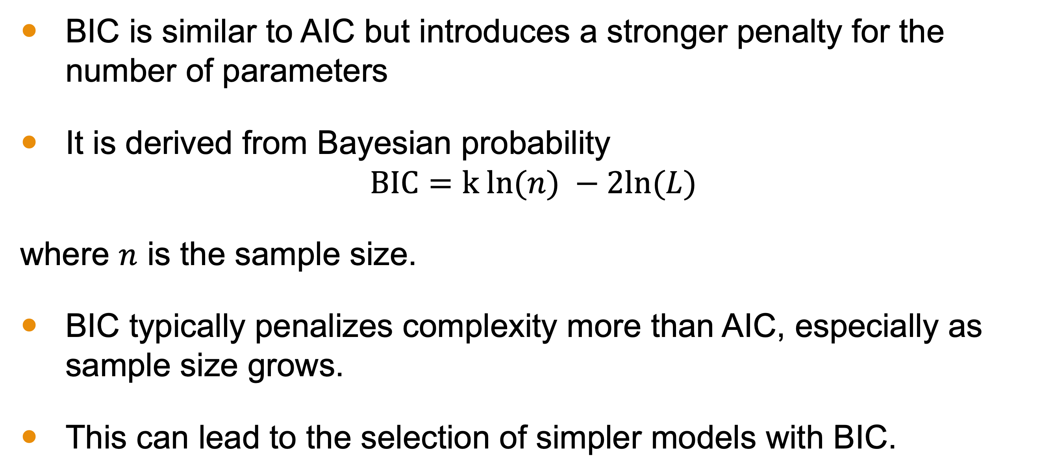
Bayesian Information Criterion (BIC)
BIC is similar to AIC but introduces a stronger penalty for the number of parameters
It is derived from Bayesian probability
$$BIC=k ln⁡(n) −2ln⁡(L)$$
where $n$ is the sample size.
BIC typically penalizes complexity more than AIC, especially as sample size grows.
This can lead to the selection of simpler models with BIC.

Slide 9
AIC and BIC in Practice
AIC is often used when the goal is predictive accuracy.
It is less strict about model simplicity
Best when the true model is complex
BIC can be preferred when aiming for a simpler model.
It's more suitable for larger datasets.
AIC and BIC are typically NOT used to estimate testing error
Best for model selection

Slide 10
Conclusion
AIC and BIC are information-based metrics that balance model complexity with fit.
AIC favors predictive accuracy more than model simplicity
BIC favors model simplicity and takes into account sample size
They are best used in model selection (e.g. tuning hyperparameters).

